Slide 1

OPERATING SYSTEMS
Case Study: Linux/ Windows Scheduling Policies.
Venkatesh Prasad
Department of Computer Science

Slide 2

OPERATING SYSTEMS
Slides Credits for all PPTs of this course
The slides/diagrams in this course are an adaptation, combination, and enhancement of material from the following resources and persons:
Slides of Operating System Concepts, Abraham Silberschatz, Peter Baer Galvin, Greg Gagne - 9th edition 2013 and some slides from 10th edition 2018
Some conceptual text and diagram from Operating Systems - Internals and Design Principles, William Stallings, 9th edition 2018
Some presentation transcripts from A. Frank – P. Weisberg
Some conceptual text from Operating Systems: Three Easy Pieces, Remzi Arpaci-Dusseau, Andrea Arpaci Dusseau

Slide 3
Operating systems
Case Study: Linux/ Windows Scheduling Policies
Venkatesh Prasad
Department of Computer Science

Slide 4
OPERATING SYSTEMS
Linux Scheduling Through Version 2.5
Prior to kernel version 2.5, ran variation of standard UNIX scheduling algorithm
Version 2.5 moved to constant order O(1) scheduling time
Preemptive, priority based
Two priority ranges: time-sharing and real-time
Real-time range from 0 to 99 and nice value from 100 to 140
Map into global priority with numerically lower values indicating higher priority

Slide 5
OPERATING SYSTEMS
Linux Scheduling Through Version 2.5 (Cont.)
Higher priority gets larger q
Task run-able as long as time left in time slice (active)
If no time left (expired), not run-able until all other tasks use their slices
All run-able tasks tracked in per-CPU runqueue data structure
Two priority arrays (active, expired)
Tasks indexed by priority
When no more active, arrays are exchanged
Worked well, but poor response times for interactive processes

Slide 6
OPERATING SYSTEMS
Linux Scheduling in Version 2.6.23 +
Completely Fair Scheduler (CFS)
Scheduling classes
Each has specific priority
Scheduler picks highest priority task in highest scheduling class
Rather than quantum based on fixed time allotments, based on proportion of CPU time
2 scheduling classes included, others can be added
default
real-time

Slide 7
OPERATING SYSTEMS
Linux Scheduling in Version 2.6.23 + (Cont.)
Quantum calculated based on nice value from -20 to +19
Lower value is higher priority
Calculates target latency – interval of time during which task should run at least once
Target latency can increase if say number of active tasks increases
CFS scheduler maintains per task virtual run time in variable vruntime
Associated with decay factor based on priority of task – lower priority is higher decay rate
Normal default priority yields virtual run time = actual run time
To decide next task to run, scheduler picks task with lowest virtual run time
Notes:
I/O bound task will have lower vruntime, so it will be given higher priority than the CU bound task (which can also be pre-empted when the I/O bound task becomes eligible to run)

Slide 8
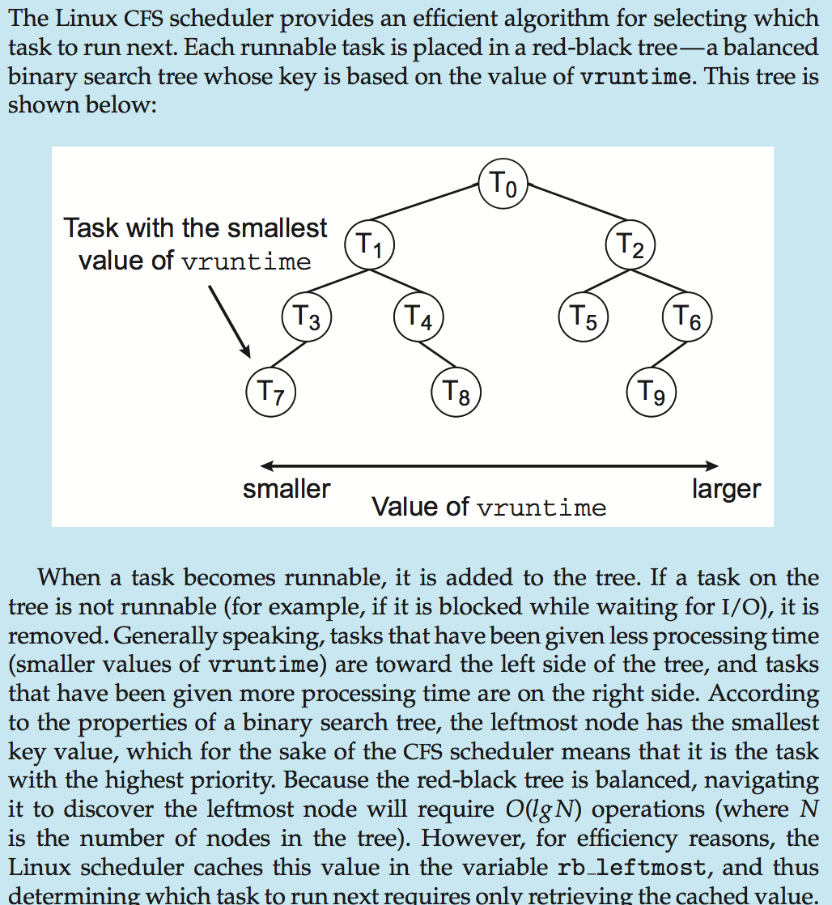
OPERATING SYSTEMS
Completely Fair Scheduler Performance

Slide 9
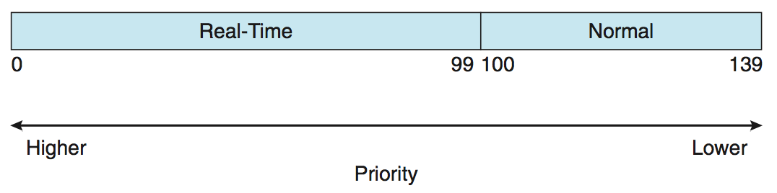
OPERATING SYSTEMS
Linux Scheduling
Real-time scheduling according to POSIX.1b
Real-time tasks have static priorities
Real-time plus normal map into global priority scheme
Nice value of -20 maps to global priority 100
Nice value of +19 maps to priority 139
Notes:
Periodic processes require the CPU at constant intervals (periods).

Slide 10
OPERATING SYSTEMS
Windows Scheduling
Windows uses priority-based preemptive scheduling
Highest-priority thread runs next
Dispatcher is scheduler
Thread runs until (1) blocks, (2) uses time slice, (3) preempted by higher-priority thread
Real-time threads can preempt non-real-time
32-level priority scheme
Variable class is 1-15, real-time class is 16-31
Priority 0 is memory-management thread
Queue for each priority
If no run-able thread, runs idle thread

Slide 11
OPERATING SYSTEMS
Windows Priority Classes
Win32 API identifies several priority classes to which a process can belong
REALTIME_PRIORITY_CLASS, HIGH_PRIORITY_CLASS, ABOVE_NORMAL_PRIORITY_CLASS,NORMAL_PRIORITY_CLASS, BELOW_NORMAL_PRIORITY_CLASS, IDLE_PRIORITY_CLASS
All are variable except REALTIME
A thread within a given priority class has a relative priority
TIME_CRITICAL, HIGHEST, ABOVE_NORMAL, NORMAL, BELOW_NORMAL, LOWEST, IDLE
Priority class and relative priority combine to give numeric priority
Base priority is NORMAL within the class
If quantum expires, priority lowered, but never below base

Slide 12
OPERATING SYSTEMS
Windows Priority Classes (Cont.)
If wait occurs, priority boosted depending on what was waited for
Foreground window given 3x priority boost
Windows 7 added user-mode scheduling (UMS)
Applications create and manage threads independent of kernel
For large number of threads, much more efficient
UMS schedulers come from programming language libraries like C++ Concurrent Runtime (ConcRT) framework

Slide 13
OPERATING SYSTEMS
Windows Thread Priorities
A thread within a given priority class also has a relative priority
Priority of each thread is based on both the priority class it belongs to (top row in the diagram) and its relative priority within that class (left column in the diagram)
Notes:
Ex: If the relative priority of a thread in the ABOVE_NORMAL_PRIORITY_CLASS is NORMAL, the numeric priority of that thread is 10

Slide 14
THANK YOU
Venkatesh Prasad
Department of Computer Science Engineering
venkateshprasad@pes.edu

